Slide 1

Software Design
Roskilde Day-care
Made by Ilias, Thomas, Rasmus, Cristian, David

Slide 2
Introduction
As a group of five, we were tasked to design and create software for Roskilde day-care centre, a small company that needed to update their Administration systems and digitalise their daily tasks. After reviewing the requirements for the System, we brainstormed a range of ideas, from essentials, to ‘nice to have’ functions. The information on the project was open to a degree of interpretation, so we set about establishing common aims and assumptions as a group.
AIMS
We wanted it to be lightweight, robust, and easy to use. It must have a simple and logical UI, as it will be used by users with a range of experience and ability. It must integrate into their existing environment with minimal retraining or disruption. We also aimed to integrate an ‘email sending’ functionality to the Java code.
ASSUMPTIONS (technical)
The day-care has one computer, accessed by one person at a time. There will be no need for any interactivity between terminals.
A member of our team will attend the day-care to do an initial installation. Certain aspects like the javaMail.jar need to be imported for all functionalities of the software to work.
From these examples, we were able to build our FURPS+

Slide 3
FURPS+
Functionality:
Create and manage information about employees, parents, and children in the system.
Create and manage employee schedules in the system.
Create and manage payment records and invoices in the system.
Have the ability to email invoices and receipts to parents email addresses once paid.
Usability:
The system aims to be user-friendly. This is achieved through simple menus with unambiguous options.
Reliability:
The system will have a low frequency of failure (ideally non-existent). The data will be saved whenever it is modified (created, changed, deleted) in case of a software/hardware crash.
Performance:
The system supports one user at a time.
The simple architecture will allow for a fast response time, with no action taking longer than 0.5s.

Slide 4
FURPS+ cont.
Supportability:
In the future, the system will be able to be connected with a cloud database that can store all information.
The system has been designed using a single controller/service class linking the front end menus to the back end database. This allows further updates to be more easily added in the future without re-writing the entire program – for example adding extra menus or switching to a GUI.
Plus +
Design constraints.
Implementation constraints.
Interface requirements: the computer may need to be interfaced with a local printer, if employees wish to print their rosters.
Physical requirements: the computer needs to be internet connected to be able to send invoices to parents via email. As stated in the Feasibility Study, it is recommended that the computer be password protected and in a lockable room as it will contain personal data.

Slide 5
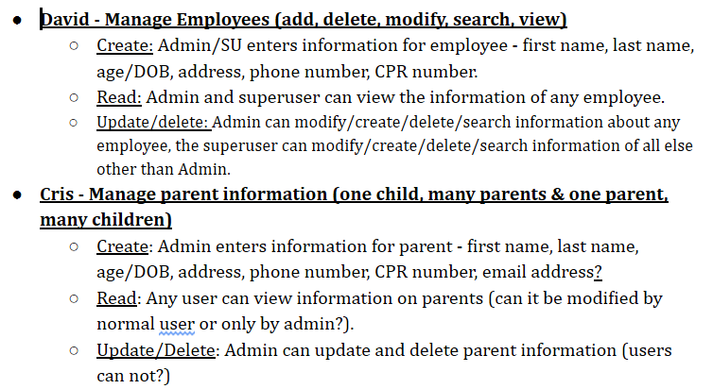
Use Cases
Use cases can be seen in full externally.
As a starting point, we used CRUD for any situation involving creation or manipulation of data. These were then expanded into a full Use Case.

Slide 6
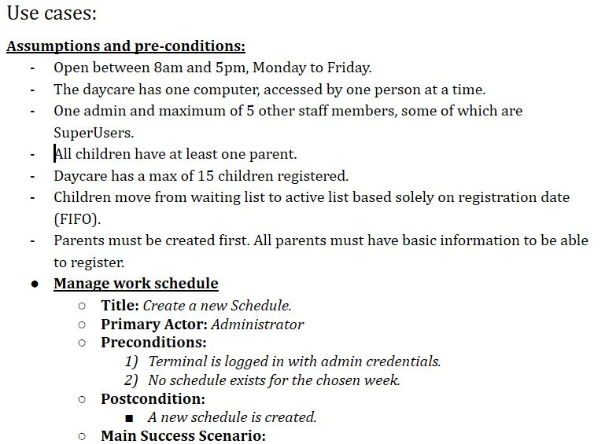
Use Cases cont.
Once developed, we established assumptions, pre-conditions, and post-conditions.
As none of us are parents or have experience in the field, we made basic assumptions on the day-to-day running of a day-care. We established it as a small, private business. We imagined a business that size would need only one computer terminal, with Sandra as the Admin/manager and five other employees. Of course the system will allow more than five employees to be entered if necessary.

Slide 7
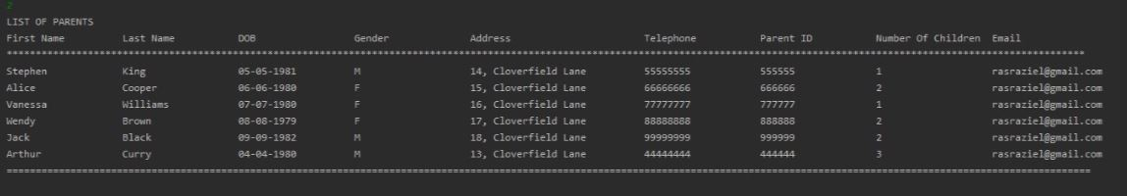
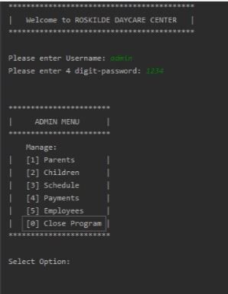
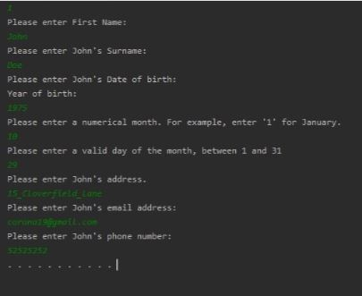
Use Cases cont.
Finally, we developed both a software and a paper prototype.
The aim of these was to check the menu layout/flow was intuitive, and that the controller and service calls interacted correctly with each other.

Slide 8
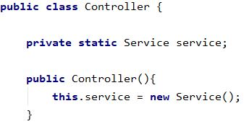
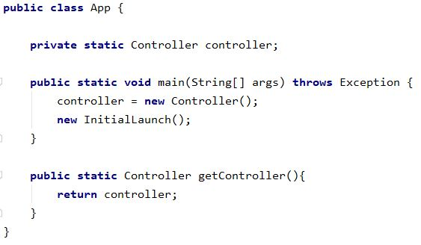
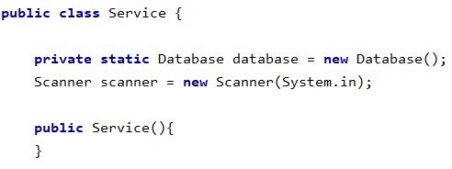
Code examples
Basic structure: the App class contains the main method, which is responsible for creating a single public controller, and launching the initial menu. The controller retrieves methods from the service class, which handles all methods, file management, and retrieval of data from the database. Thus, using App.getController() will result in any method being retrieved.

Slide 9
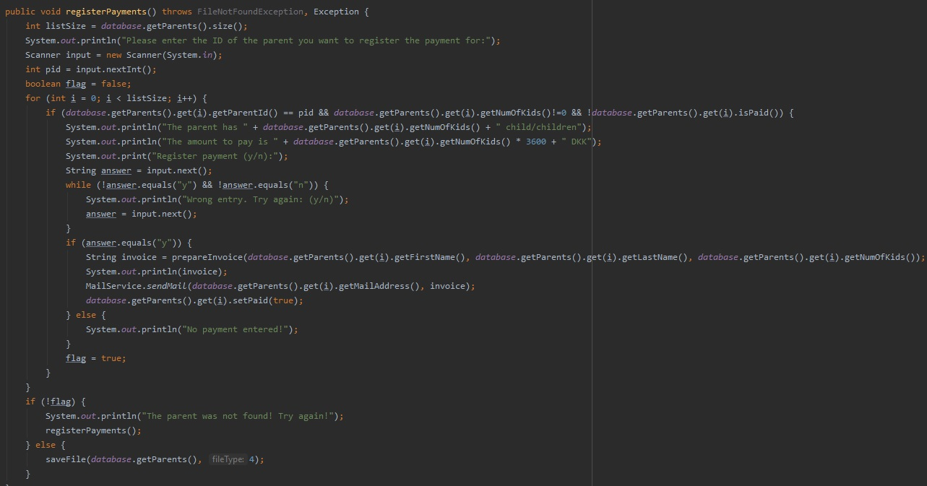
An important part in the program had to with parents' payment to Roskilde Day-care. Obviously not all parents have to pay, so we included a boolean variable “isPaid” (field in SQL) to the Parent class. If a parent has not paid and has more than 0 children, then (and only then) can they pay. The payment is calculated as (no. of children x 3600 DKK). After the payment has been entered, the boolean isPaid becomes true, an invoice is printed to the console and also sent via e-mail (which will be covered below)

Slide 10
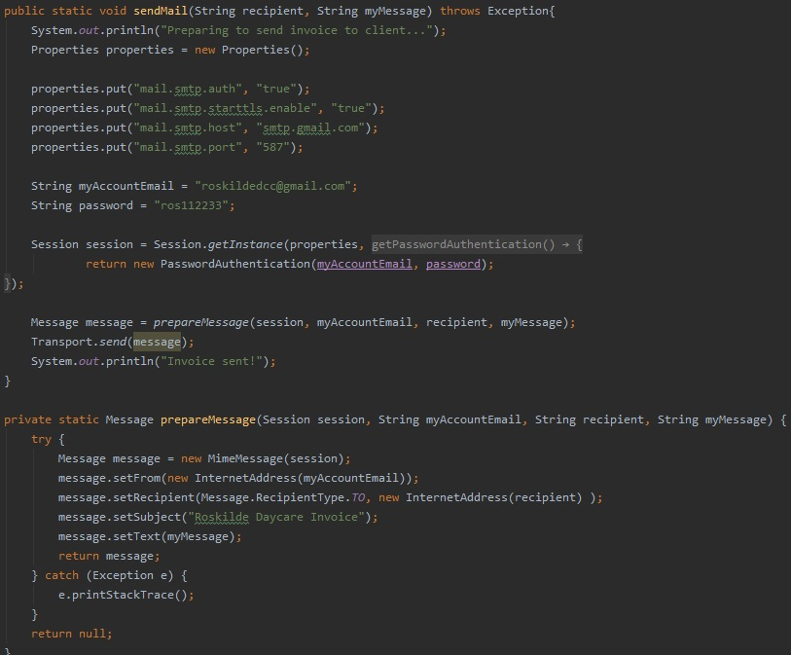
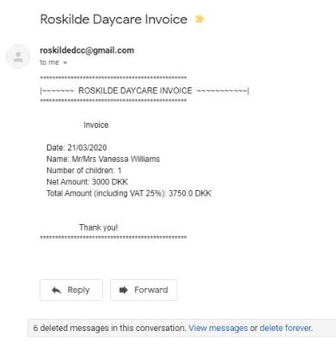
Code examples cont.
One problem we had was how to deliver invoices to the customer. Our system is only used by staff, and the parent cannot see the printed invoice on the console. We came up with the idea to send an e-mail to the parent.
Using the Java Mail library(javax.mail.jar) we were able to connect a gmail account into Java, and Java created an e-mail message along with a title and sent it to the parent's e-mail. The invoice that was printed in the console was also saved as a String and passed as a parameter to the sendMail method of the MailService class. There it was used as the body of the e-mail message.

Slide 11
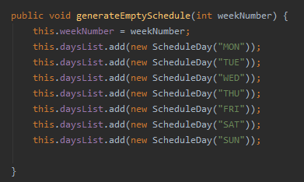
Code examples cont.
In the program, all the schedules consists of two classes. First is a ScheduleDay class, with fields that hold information on the individual day, which are the name of the day and an ArrayList<String> storing the employees working that day (stored as their CPR numbers). The other class is the ScheduleWeek class, with its fields being the number of the week the schedule is made for, and an ArrayList<ScheduleDay>, with 7 elements (one for each day of the week).
The constructors for ScheduleWeek have a method call for the class method generateEmptySchedule(), which accepts a weekNumber as the only parameter, and from there instantiates 7 objects in the ArrayList<ScheduleDay> daysList. The default constructor also calls generateEmptySchedule() and passes in a hardcoded -1 for the weekNumber. However, the default constructor is not accessible when running the program, as no method calls it.

Slide 12
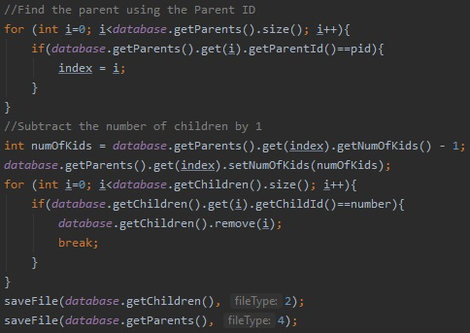
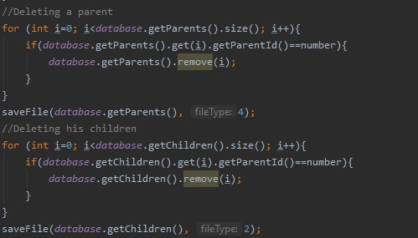
The parents and the children are interconnected in this application.
If we choose to remove a parent using the parentID, all their children(if any) who also contain a ParentID variable are deleted.
In SQL we would use the ParentID of the parent table as Primary Key, and the ParentID of the children table as Foreign Key.
If we choose to remove a child, the numOfKids variable value of the Parent is decreased by 1.
Each action updates both our ArrayLists and txt files (or SQL)

Slide 13
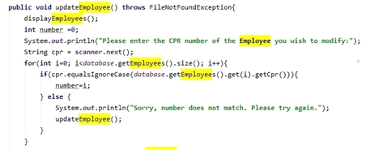
Code cont.
Managing the employee's information is essential for running a business, as there can be changes in contact information.
A good illustration of this could for example be the updateEmployee() function.
The Admin wants to update an employee, and have chosen so, through the menu after she logged in. The CPR being the search term in this, you would have to write the CPR to find the employee before changing it.
Briefly, here’s how the admin interacts with the system:
The system displays employees, and asks for CPR of the person to update.
The admin types in the CPR, the system takes it as a string, and loops through the database employee array list.
The objects in the array list “employees” matches CPR as searched, else it loops back to updateEmployee()
From here, the system takes in an integer from the Admin, specifying which information they want to change.
Then, the Admin types in an answer to the updated information.
The system uses the “set” function for each attribute (Ex. SetFirstName()), and the name updates
The system saves the name in database employees, through saveFile()

Slide 14
Project Contents
Use Cases (sent as .vpp files and .pdf in email).
Conceptual model.
Feasibility Study and Gantt chart.
Java code (and .wmv video/ readme.txt file for installation of javaxMail.jar file to enable live emails).
SQL code and EER diagram.
Paper prototype as .xd file (also link here: https://xd.adobe.com/view/72f05bea-6171-4743-474d-fa73acdbf2f8-04c1/screen/28ecfd28-ad55-4437-ba0a-9674bf1e5401/logIn ).

Slide 15
Summary
Overall, we achieved the main goals we were aiming for.
We had wanted it to be lightweight, and were able to complete the program using a limited amount of code, with very low system requirements.
We aimed for it to be robust, and it is. We have had zero runtime errors during three different rounds of testing, and through wide use of try/catch in methods and exception handling, we have not found anything that leads to fatal errors.
We also desired that it was straightforward for beginner users. We utilised ‘outside testers’ – people unfamiliar with the program such as our partners and flatmates, and the feedback was generally positive, even from those who weren’t used to navigating a console. The menus and their flow made sense, and the UX didn’t suffer from the lack of a GUI.
Another aim was that it must integrate into their existing environment with minimal retraining or disruption. This is obviously hard to judge in a simulated environment, but there is nothing that leads us to believe this would be untrue.
Finally, we also aimed to integrate an ‘email sending’ functionality to the Java code. Ilias was able to get this functioning using the javaMail.jar and received emails containing parent invoices to be paid, in real time.

